Slide 1

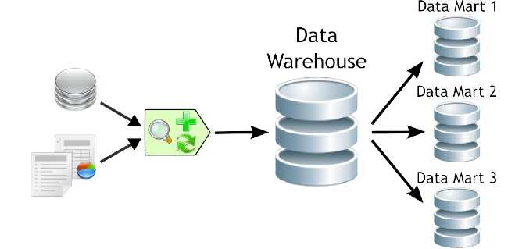

Data Mart Fundamentals
A Data mart is a small data warehouse focused on a specific area of interest. Data warehouses can be subdivided into data marts for improved performance and ease of use within that area.

Slide 2
Objectives
Through this chapter you will be able to understand:
What is a Data mart?
How it is different from Data warehouse.
Dependent & Independent
Data mart.
Advantages of Data mart.

Slide 3

Data mart
Let me explain why we need Data mart?
The primary purpose for its existence is to support data dependent business functions related to reporting, trending, analysis & presentation.
Data mart is a simple form of a data warehouse that is focused on a single subject.
It provides the business unit with easy access to data in the warehouse.

Slide 4
Data mart Overview
What is a Data mart?
Data mart is a decentralized subset of data found either in a Data Warehouse or as a standalone subset designed to support the unique business unit requirements of a specific decision-support system.
Data marts have specific business-related purposes such as measuring the impact of marketing promotions, or measuring and forecasting sales performance, and so on.

Slide 5
Basic Architecture of Data mart
Data mart
Enterprise Data Warehouse
Data mart

Slide 6
Data mart: Features
The following are few important features of data marts:
Low cost.
Controlled locally rather than centrally, conferring power on the
user group.
Contain less information than the warehouse.
Rapid response.
Easily understood and navigated than an enterprise Data Warehouse.
Within the range of divisional or departmental budgets.
To provide data in a form that matches the collective view of a group of users.

Slide 7
Data mart: Types
There are following 3 types of Data marts:
Independent
Dependent
Hybrid

Slide 8
Independent Data mart
What is an Independent Data mart?
An independent data mart is created without the use of central data warehouse. This could be desirable for smaller groups within the organization, It is not, however, the focus of the guide.

Slide 9
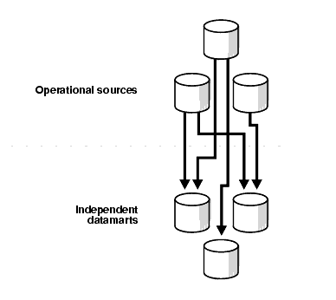
Architecture of Independent Data mart

Slide 10
Dependent Data mart
What is a Dependent Data mart?
A dependent data mart allows you to unite your organization’s data into 1 data warehouse.

Slide 11
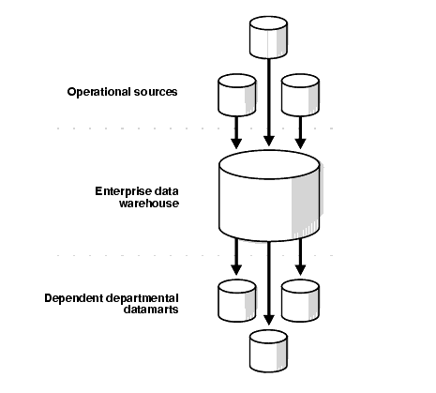
Architecture of Dependent Data mart

Slide 12
Hybrid Data mart
What is a Hybrid Data mart?
A hybrid data mart allows you to combine input from sources other than a data warehouse. This could be useful for many situations, especially when you need ad hoc integration, such as after a new group or product added to the organization.

Slide 13
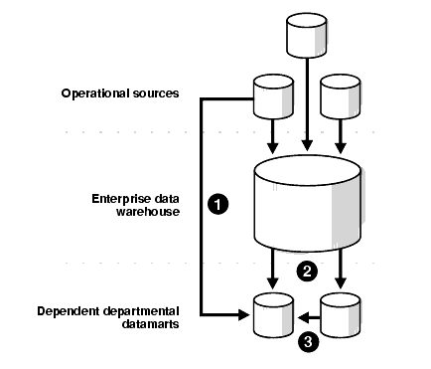
Architecture of Hybrid Data mart

Slide 14
Advantages of Data Mart over Data Warehouse
Data mart advantages:
Typically single subject area and fewer dimensions.
Limited feeds.
Very quick time to market (30-120 days to pilot).
Quick impact on bottom line problems.
Focused user needs.
Limited scope.
Optimum model for DW construction.
Low Cost.
Allows prototyping.
Quick respond to queries.

Slide 15
Data mart Disadvantages
Data mart Disadvantages:
Does not provide integrated view of business information.
Uncontrolled proliferation of data marts results in redundancy.
More number of data marts complex to maintain.
Scalability issues for large number of users and increased
data volume.

Slide 16
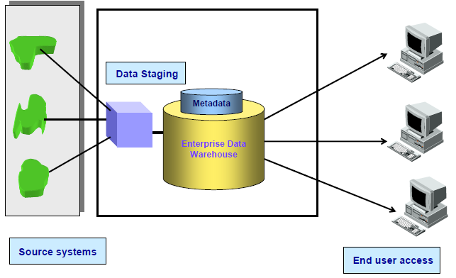
Architected data warehouse

Slide 17
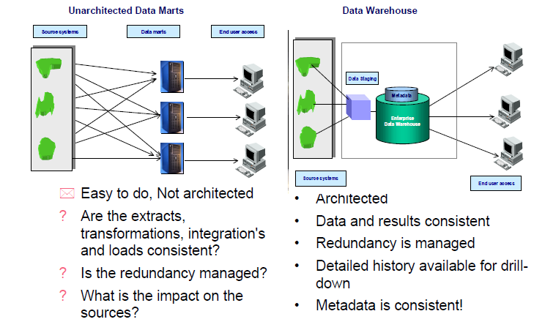
Unarchitected Data mart Vs Data warehouse

Slide 18
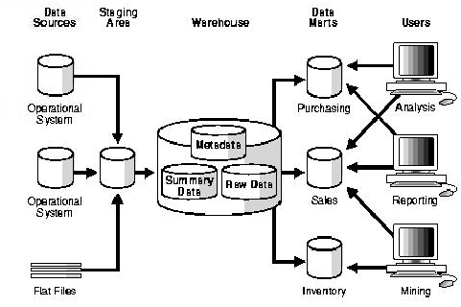
Example for Data mart

Slide 19
Real Life Example for Data mart
There is a Client “A” who is willing to analyze the data for its “Finance Department” only. He is not willing to spend more money for it and having a small amount of data.
He just want to store data for 4 to 5 year.
He need a fast response system, So that he can get the results of his queries fast.
As per the requirement of the client we need to go for Data Mart in spite of
Data Warehouse.
He is having small amount of data and need it just for 4 to 5 years.
He want a fast response time
He is much focused for a single domain of Finance.
He is not willing to spend more amount for his reports.
General Tips:
We must analyze the requirement first before proceeding towards Data Warehouse or Data Mart.
If requirements are less then we must follow the Data Mart approach.

Slide 20
Summary
Data mart is subset of a data warehouse that supports the requirements of a particular department or business function.
Do not normally contain detailed operational data unlike data warehouses.
May contain certain levels of aggregation.
Tree, graph, table and sets are Non linear data structures.
To give users more flexible access to the data they need to analyse most often.
The cost of implementing data marts is far less than that required to establish a data warehouse.

